Slide 1

Responsible and Safe AI Systems
SEMANTIC UNCERTAINTY ANALYSIS
TEAM LLAMA
Yash Shivhare
Arush Sachdeva
Vrinda Agarwal

Slide 2
01
INTRODUCTION
02
DATASETS AND MODELS
03
RESEARCH METHODOLOGY
CONTENT
04
RESULT ANALYSIS
05
CONCLUSIONS
06
REFERENCE

Slide 3
INTRODUCTION

Slide 4

THE PROBLEM
AI models sometimes struggle with semantic equivalence, assigning different confidence levels to phrases with the same meaning (e.g., "My name is X" vs. "It's X").
Hypothesis: This semantic confusion might be linked to AI hallucinations, where the model generates outputs inconsistent with the input data.
Project Goal: Investigate the relationship between semantic uncertainty, lexical similarity, and hallucinations in question-answering AI models.

Slide 5
DATASETS AND MODELS

Slide 6
DATASETS
Stanford Question Answering Dataset (SQuAD)
CoQA (Conversational Question Answering Challenge)
MODELS
QA Model (deepset/roberta-base-squad2): Extracts answers and assesses truthfulness.
NLI Model (facebook/bart-large-mnli): Evaluates semantic similarity using bi-directional entailment.
CLM Model (GPT-2): Calculates the probability of generated answer sequences.

Slide 7
RESEARCH METHODOLOGY

Slide 8
Key Functions Implemented:
Generate Answers: Uses the QA model to produce top N possible answers.
Check Entailment: Evaluates semantic similarity between sentences using the NLI model.
Cluster Answers: Groups similar answers based on bi-directional entailment.
Calculate Average Clusters: Determines the average number of clusters for correct and incorrect answers.
Calculate p_true: Estimates the probability of an answer being true.
Calculate Lexical Similarity: Measures similarity between generated and reference answers using ROUGE-1.
Calculate Semantic Entropy: Assesses the diversity of information within answer clusters.
Calculate Sequence Log Probability: Determines the likelihood of generated answer sequences using the CLM model.

Slide 9
RESULT ANALYSIS

Slide 10
Initial Findings:
A strong correlation (0.968) was observed between semantic uncertainty and hallucinations in the CoQA dataset. However, this correlation did not hold for the larger SQuAD dataset, indicating a more complex relationship.
Metrics Used:
AUROC: Evaluated the performance of different uncertainty estimation methods (Semantic Entropy, Lexical Similarity, PTrue) across various models, showing Semantic Entropy's robustness, especially in larger models.
Feature Importance: Analyzed the impact of different features in a Gradient Boosting model, revealing Lexical Similarity and PTrue as key drivers of prediction accuracy.
Nonlinear Regression: Visualized the complex relationship between Semantic Entropy, Lexical Similarity, and model outputs, highlighting their interconnectedness.
Wasserstein Distance:
Illustrated the nearness of the joint probability distribution of semantic entropy and lexical similarity with average hallucinations, suggesting a potential link.

Slide 11
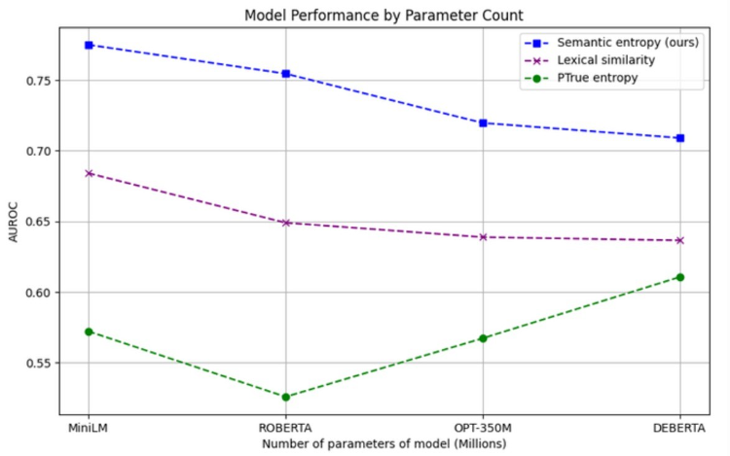

Slide 12
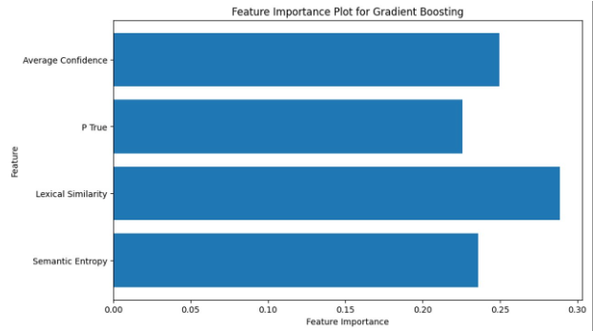

Slide 13
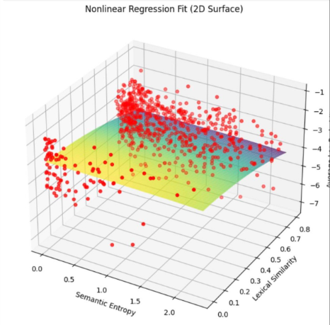

Slide 14
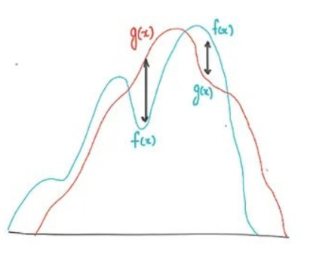

Slide 15
CONCLUSIONS

Slide 16
KEY INSIGHTS:
The relationship between semantic uncertainty, lexical similarity, and hallucinations is complex and may vary depending on the dataset and model used.
Semantic Entropy appears to be a reliable measure of uncertainty, especially for larger models.
Lexical Similarity and PTrue are significant factors influencing model predictions.
Further investigation is needed to fully understand the interplay of these factors and their impact on AI hallucinations.

Slide 17
REFERENCES

Slide 18
[1] Kuhn, L., Gal, Y., & Farquhar, S. (2023). Semantic uncertainty: Linguistic invariances for uncertainty estimation in natural language generation. arXiv preprint arXiv:2302.09664.
Guerreiro, N. M., Voita, E., & Martins, A. F. (2022).
[2] Looking for a needle in a haystack: A comprehensive study of hallucinations in neural machine translation. arXiv preprint arXiv:2208.05309.

Slide 19
THANK YOU

